Slide 1
Features Overview
PART 2/2

Slide 2
Agenda
Site2Cloud
User VPN
FireNet
ThreatIQ with ThreatGuard

Slide 3
Site2Cloud (S2C)
And Other Services to Connect to External Networks

Slide 4








Problem Statement
Applications live in the public cloud, but the consumers are mostly outside
Branches, customers, partners, service providers, etc
Requirement to connect privately:
Over public IPs with encryption (e.g. IPsec)
Over private IPs (DX/ER/CI/FC)
Challenges:
IPsec deployment and day-2 operations (visibility, troubleshooting)
Overlapping IP addresses within the cloud or across clouds
Mergers and acquisitions
Autonomous line of business
Shadow IT
App1
App2
Transit
On-Prem
Data Center / Branch

Slide 5









Aviatrix Multicloud Network Architecture
Aviatrix Controller
Spoke
Spoke
Spoke
Spoke
Spoke
Spoke
Cloud Application
Cloud Core
Transit
Transit
Transit
Cloud Access
VPN
Cloud
Partner / Third Party
On-Prem
Data Center / Branch
SD-WAN

Slide 6

Site2Cloud Introduction
Aviatrix Controller
Spoke
Spoke
Spoke
Spoke
IPsec connection to Public Cloud:
On-Prem DC
3rd Party Appliances, SD-WAN
Branch
Clouds Native Constructs (VPCs/VNets/VCNs)
CLOUD
Transit
Transit
Landing
Spoke
Branch
SITE
Connecting
to the cloud
VPN
Cloud
Partner / Third Party
On-Prem
Data Center / Branch
SD-WAN
5

Slide 7
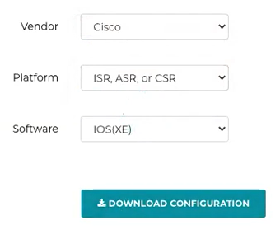
Site2Cloud Solution
Aviatrix Controller
Spoke
Spoke
Spoke
Spoke
Easy to use and template-driven
Built-in diagnostic tools
Solves Overlapping IPs Challenges
CLOUD
Transit
Transit
Landing
Spoke
Branch
SITE
Connecting
to the cloud
VPN
Cloud
Partner / Third Party
On-Prem
Data Center / Branch
SD-WAN
6

Slide 8
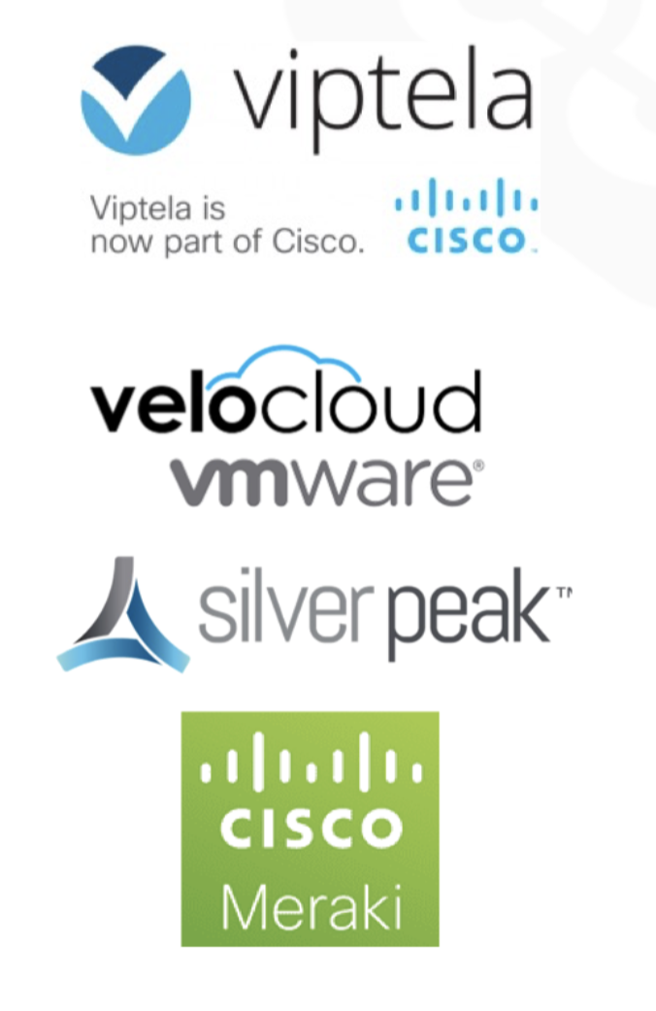

Solution – SD-WAN integration with Aviatrix
BGP based integration with SD-WAN cloud instances
BGP over IPsec
BGP over LAN
BGP over GRE
Service chaining by inspecting traffic with Next Gen Firewalls
Advanced Traffic Engineering and Filtering options
All other Aviatrix benefits apply

Slide 9
User VPN
Cloud Based Secure User Access

Slide 10
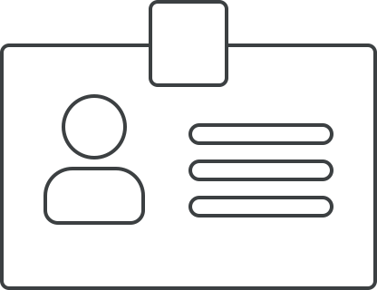










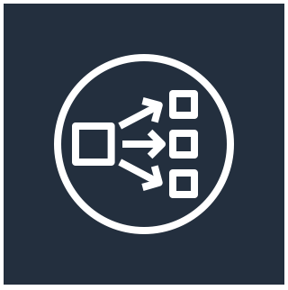

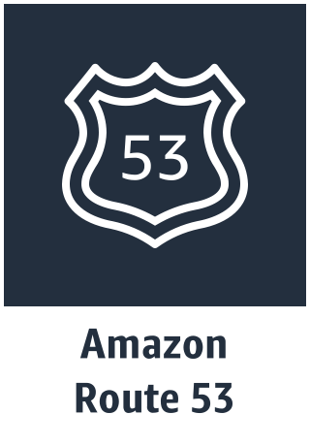

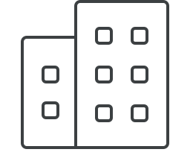



Solution – User VPN
Enterprise
Identity Providers
SAML
VPCs
GCP
Profiles
VPC
VPC
Partners
VPN VPC
OpenVPN
Contractors
NLB
Transit VPC
Employees
Transit VNet
VNets
Remote Users
Aviatrix
Controller
Geo VPN
User Accelerator
Azure
Data Center

Slide 11
FireNet (Firewall Network)
Firewall Insertion

Slide 12









Aviatrix Transit Firewall Network
Spoke-1
Spoke-2
Spoke-3
Spoke-4
Policy-based scale out, multi-AZ FW deployments
Automated route management, Segmentation and Connection Policies
Aviatrix ActiveMesh
Transit
Deep visibility and operational capabilities
Repeatable architecture, across regions and clouds
IPsec
VPN
Direct Connect/
Express Route
Bring Your Own Appliance

Slide 13



Centralized Stateful Firewall
Strategic Advantage:
Centrally placed L4 Stateful Firewall
Control traffic from VPCs to destinations like other VPCs/VNets/VCNs, Other regions, other clouds, On-Prem, internet etc.
NetSec conveniently controls all transit traffic
AppDev teams control instance security (intra-VPC/VNet)
Best for small scale environments/no NGFW
Using Aviatrix Single AZ HA
Spoke 1
Spoke 2
Technical Details:
Allow, Deny, Force Drop CIDRs, protocols and ports
Tags (collection of CIDRs) simplify rule creation
Best for single GW use cases supported by Single AZ HA
Optimal Location
Transit
Operational Benefits:
Aviatrix Controller manages route tables and HA
No additional component needed (LB, additional hop, etc.)
Multi-Cloud – same rules and policies applicable in any cloud
NetSec

Slide 14



Aviatrix Transit FireNet
APPLICATIONS LAYER
Spoke VPC 1
Spoke VPC 2
Spoke VNet 1
Spoke VNet 2
Spoke VPC 1
Spoke VPC 2
Transit VNet
TRANSIT LAYER
Transit VPC
Transit VPC
OPERATIONS
NGFW
NGFW
NGFW
NGFW
NGFW
NGFW
AZa
AZb
ACCESS LAYER
Azure
GCP

Slide 15
ThreatIQ with ThreatGuard
Identify and remediate Threats across Multicloud and Hybrid Networks

Slide 16
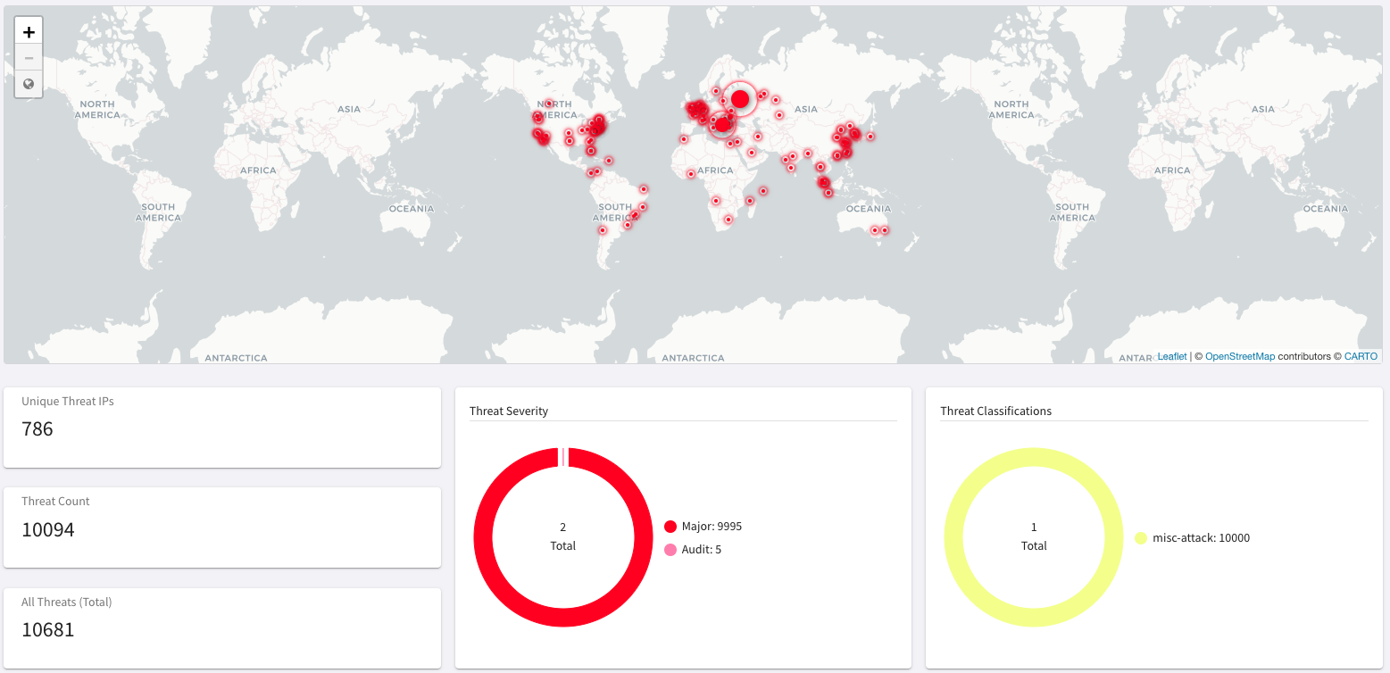
Solution – ThreatIQ with ThreatGuard
Multicloud native network security to dynamically identify, alert, and remediate potential threats to known malicious destinations
Distributed threat visibility and control built into the network data-plane at every hop
Identify potential data exfiltration and compromised host
No data-plane performance impact
Complementary security solution with full multi-cloud support

Slide 17
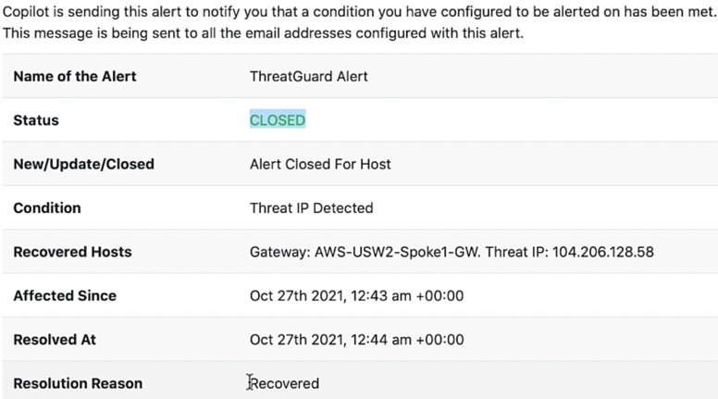
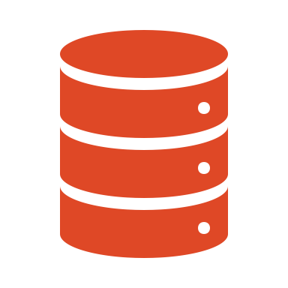




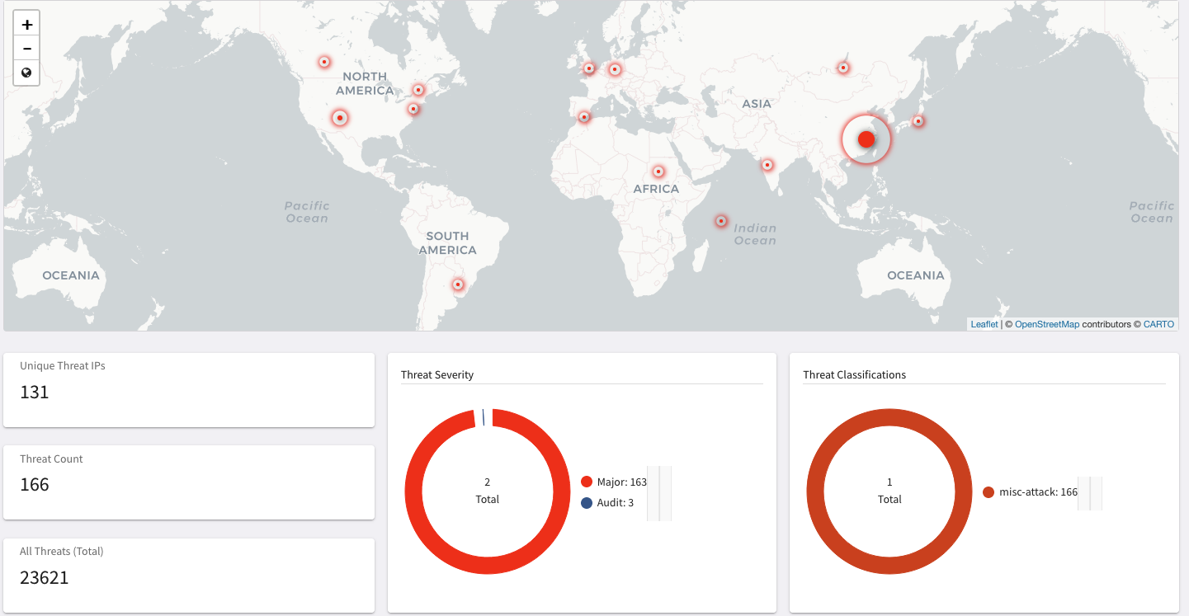
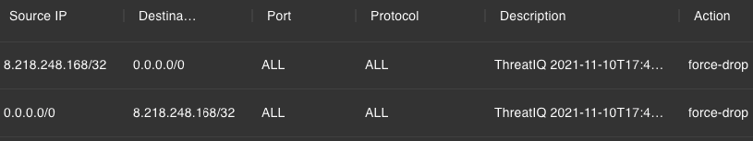


Workflow
4
ALERT
Aviatrix
Controller
Aviatrix
CoPilot
2
Threat DB
ANALYZE
ALERT
5
REMEDIATE
3
VISUALIZE
ALERT
1
DISCOVER
Firewall Rules
VPC
VPC
VNet
VNet
VPC
VPC
VCN
VCN
Visibility across entire multi-cloud network

Slide 18
Next: Operations

